Slide 1

KEY MANAGEMENT AND DISTRIBUTION
Chapter 14

Slide 2
Outlines
Symmetric-Key Distribution.
Kerberos.
Symmetric-Key Agreement.
Public-Key Distribution.
Public-Key Infrastructure.

Slide 3
Learning Objectives
In the end of this Chapter 14, students will be able:
To understand the importance and techniques of symmetric-key distribution.
To understand and describe briefly the Kerberos as an authentication server and key-distribution center.
To understand the technique of symmetric-key agreement.
To understand the importance and techniques of public-key distribution.
To understand the basic concept of public-key infrastructure.

Slide 4
SYMMETRIC-KEY DISTRIBUTION

Slide 5
Symmetric-Key Distribution – Overview
Symmetric-key cryptography is generally more efficient than asymmetric-key cryptography for encrypting large messages.
However, the challenging task in this symmetric-key cryptography is the establishment and distribution of the shared secret key between two communicating parties.

Slide 6
Symmetric-Key Distribution – Overview
There are several ways that two parties Alice and Bob can achieve secret key distribution:
Alice can select a key and physically deliver it to Bob.
A third party can select a key and physically deliver it to Alice and Bob.
If Alice and Bob have previously and recently used a secret key, either one can transmit to the other a new secret key encrypted using the current key.
If Alice and Bob has an encrypted connection to a third party, then it can deliver a secret key on the encrypted links to both Alice and Bob.

Slide 7
Symmetric-Key Distribution – Key-Distribution Center (KDC)
One practical solution is the use of Trusted Third Party (TTP), referred to as Key-Distribution Center (KDC).
Each user establishes a shared secret key with the KDC to reduce the number of keys needed.
For example, if Alice wants to send secret message to Bob, she will first send a request a session secret key from KDC for her and Bob. KDC relays such request to Bob and if Bob agrees, a session key is created for their secure communication. Such session key between Alice and Bob with KDC is used for authentication purpose too. (We will learn more about the session key in the later slides.)

Slide 8
Symmetric-Key Distribution – Key-Distribution Center (KDC)

Slide 9
Symmetric-Key Distribution – Flat Multiple KDCs
When the number of users using a KDC increases, the system can become unmanageable and reach a bottleneck.
To resolve this, a multiple KDCs can be established, and world can be divided into a few domains. Each domain can have one or more KDCs for redundancy in case of potential failure.
One example of such multiple KDCs is the Flat Multiple KDCs, in which key-distribution is made possible for users in different domains.

Slide 10
Symmetric-Key Distribution – Flat Multiple KDCs

Slide 11
Symmetric-Key Distribution – Hierarchical Multiple KDCs
The concept of Flat Multiple KDCs can be extended to a hierarchical system of KDCs, with one or more KDCs on top of the hierarchy. For instance, local KDCs, national KDCs, and international KDCs.
The request is made in such a way that it relays level by level until it reaches the desired destination.

Slide 13
Symmetric-Key Distribution – Session Keys
When KDC creates a secret key for each user, the key is used between KDC and users, NOT between users themselves.
For users to establish their shared secret key, KDC creates a session key for such a purpose upon request. This session can be used only once, and it becomes useless when the communication is terminated.
There are several approaches in which session keys can be established.
Simple (Basic) Protocol using a KDC. (We only focus on this in this course)
Needham-Schroeder Protocol.
Otway-Rees Protocol.

Slide 14
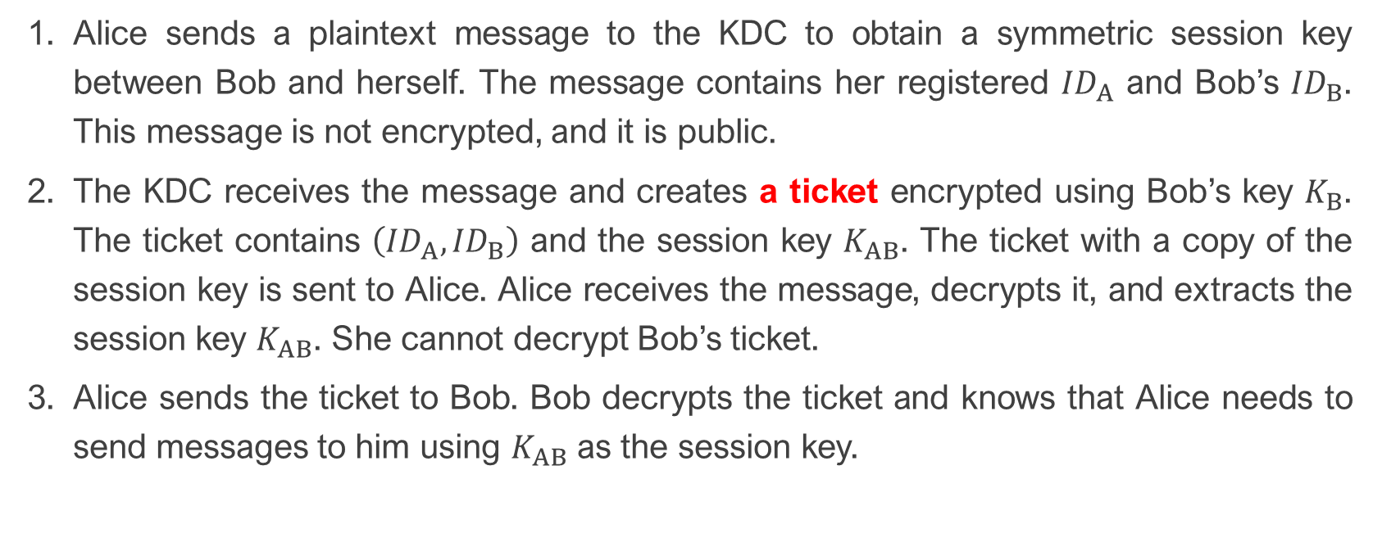
Session Keys via Simple Protocol
Alice sends a plaintext message to the KDC to obtain a symmetric session key between Bob and herself. The message contains her registered ${ID}_{A}$ and Bob’s ${ID}_{B}$. This message is not encrypted, and it is public.
The KDC receives the message and creates a ticket encrypted using Bob’s key $K_{B}$. The ticket contains $\left({ID}_{A},{ID}_{B}\right)$ and the session key $K_{AB}$. The ticket with a copy of the session key is sent to Alice. Alice receives the message, decrypts it, and extracts the session key $K_{AB}$. She cannot decrypt Bob’s ticket.
Alice sends the ticket to Bob. Bob decrypts the ticket and knows that Alice needs to send messages to him using $K_{AB}$ as the session key.

Slide 15
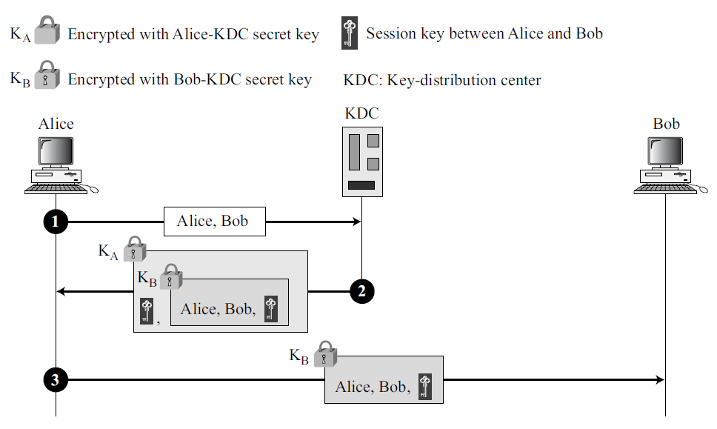

Slide 16
Session Keys via Simple Protocol
Notes:
In Step 2, the message contains a double encryption; the ticket is encrypted, and the entire message is also encrypted. In the second message, Alice is authenticated to the KDC, because only Alice can open the whole message using her secret key with KDC.
In Step 3, Bob is authenticated to the KDC as only Bob can open the ticket. Since Bob is authenticated to the KDC, he is also authenticated to Alice, who trusts the KDC. In the same way, Alice is also authenticated to Bob, because Bob trusts the KDC and the KDC has sent Bob the ticket that includes the identity of Alice.

Slide 17
KERBEROS

Slide 18
Kerberos
Kerberos is an authentication protocol at the same time a KDC. It is popularly used in the Windows 2000.
It is originally designed at MIT and has gone through several versions.
In this course, we consider only the Version 4.

Slide 19
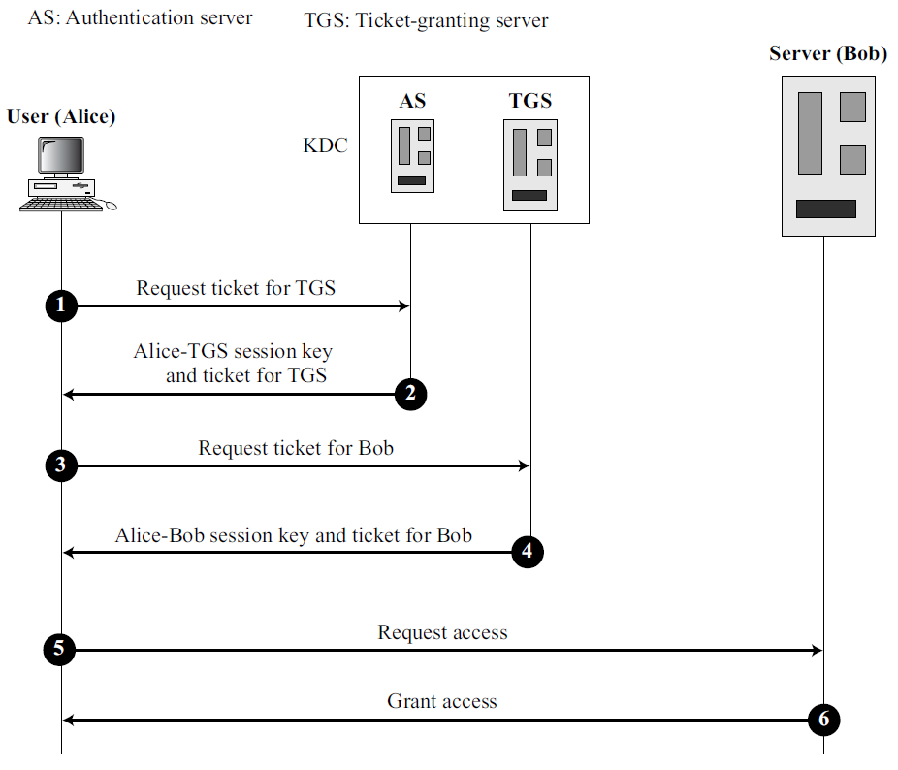
Kerberos (Overview)
The Kerberos servers.
AS: This is the KDC in Kerberos protocol.
TGS: It issues a ticket for the real server (service provider).
Real Server: The service provider for requested user.

Slide 20
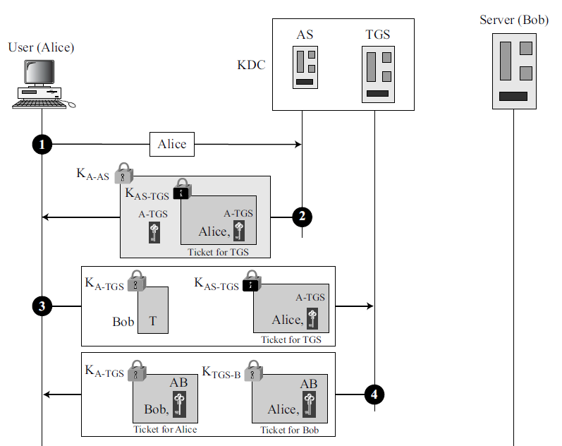
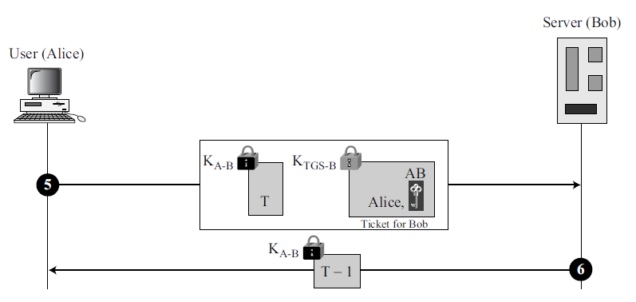
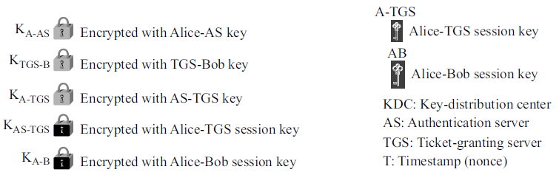
Kerberos (Example)
Can you explain verbally (or write in the algorithmic flow) on how the Kerberos works as authenticating server and KDC?

Slide 21
SYMMETRIC-KEY AGREEMENT

Slide 22
Symmetric-Key Agreement
It is possible for Alice and Bob to establish a session key without needing the help of a KDC. Such an establishment is referred to as symmetric-key agreement.
The most common method for such an objective is the Diffie-Hellman Key Exchange.
Since we have covered the DHKE completely in Chapter 9, you are advised to refer to the notes for another revision.
In the next slide, we outline the general framework once again.

Slide 23
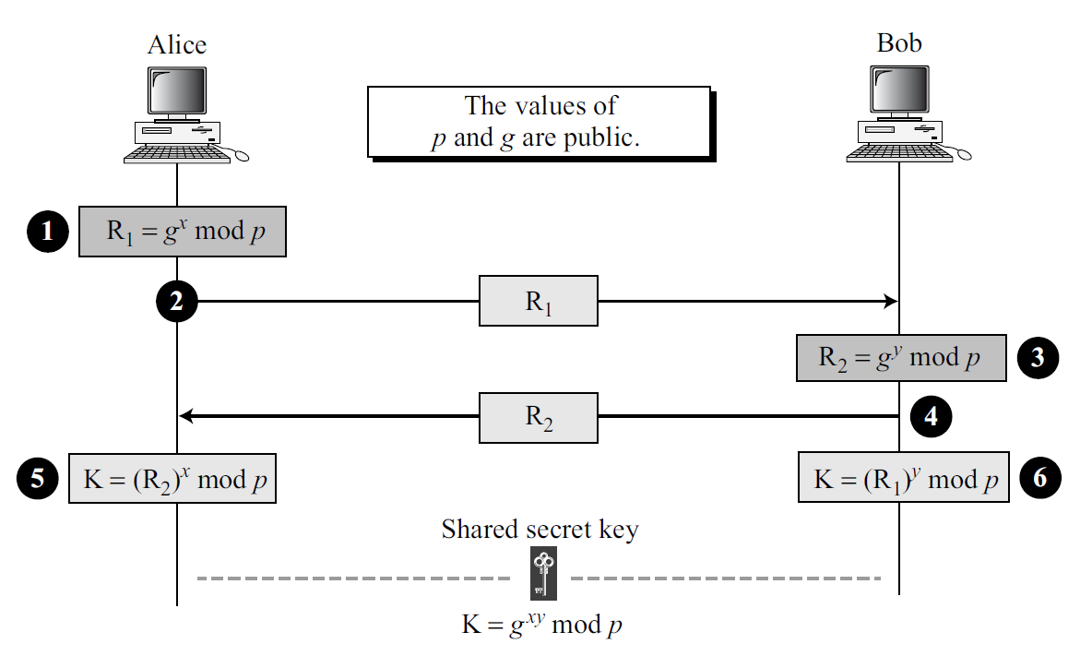

Slide 24
PUBLIC-KEY DISTRIBUTION

Slide 25
Public-Key Distribution
In public-key cryptography, users do not have to share a symmetric key.
Since every user has his/her own pair of public-private keys, message transmission can be executed immediately using the public keys.
As public keys are available to any users, distributing the keys must be done accordingly for them to be useful. There are several ways that this can be done:
Public Announcement.
Trusted Center.
Controlled Trusted Center.
Certification Authority (CA).

Slide 26
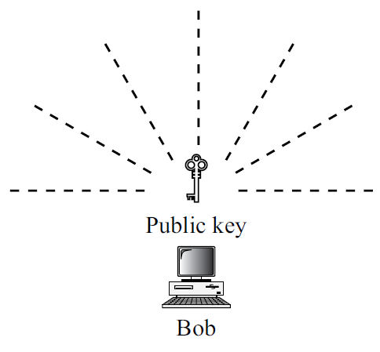
Public-Key Distribution – Public Announcement
The naïve approach in which users publicly announcement their public keys on the website, or local newspapers (or any media that public can access easily).
The approach is insecure since forgery is possible by an adversary.

Slide 27
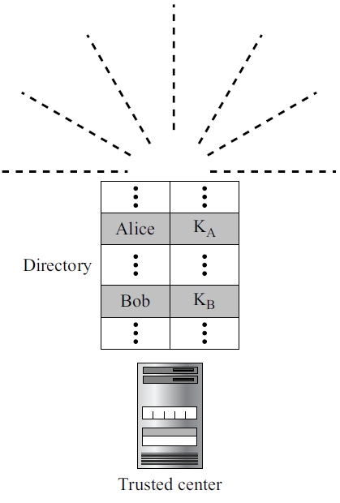
Public-Key Distribution – Trusted Center
A more secure approach where a trusted center retains a public directory of all the public keys and dynamically updates it regularly.
Users can submit their public key to the trusted center and keep their private securely with them.
Such approach will require the users to register themselves for identification purpose in the future.

Slide 28
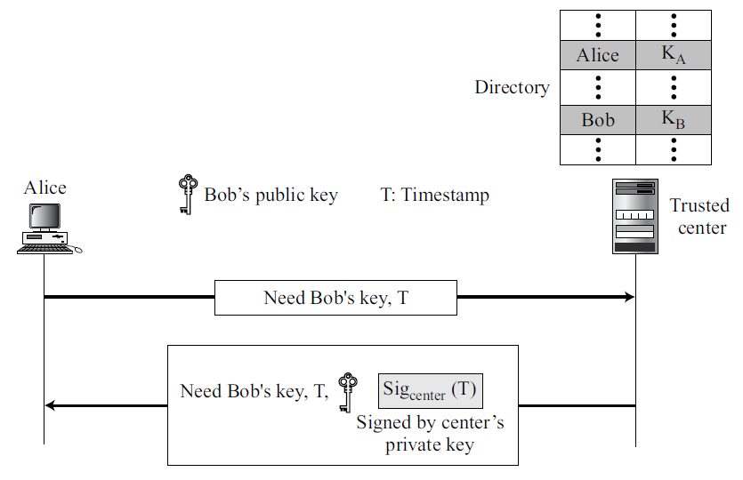
Public-Key Distribution – Controlled Trusted Center
A higher level of security compared to trusted center.
The public key announcements can include timestamp and signed by the authority to prevent interception and modification of the response.

Slide 29
Public-Key Distribution – Certification Authority
All previous approaches can result heavy load on the center if the number of public key requests is large.
An alternative solution is to create public-key certificates which involves a certificate authority (CA) that binds a public key to the user and issues a certificate.
This approach can prevent users’ public keys from being forged since any submitted public keys for certification will be signed by CA using CA’s private key.

Slide 30
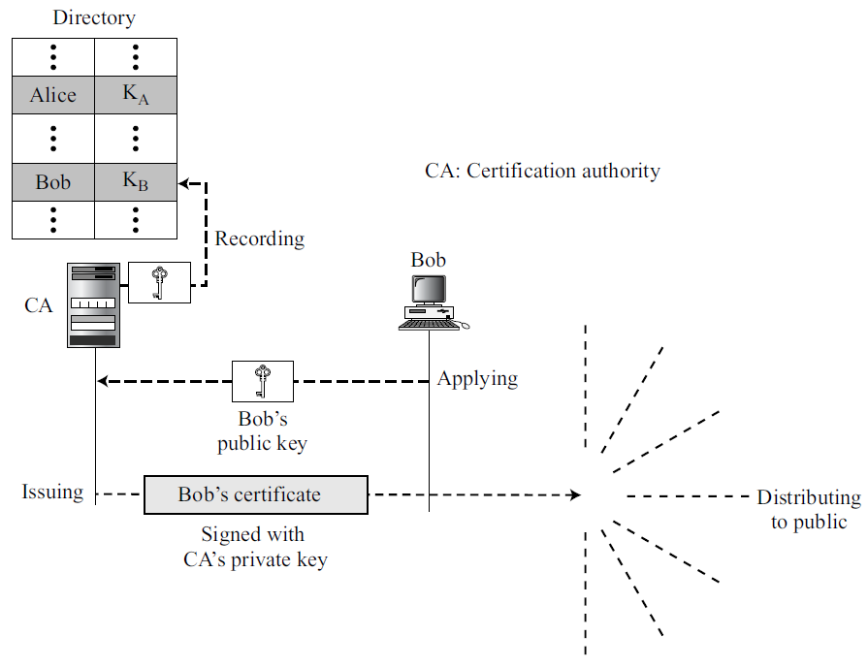

Slide 31
PUBLIC-KEY DISTRIBUTION X.509 CERTIFICATION

Slide 32
Public-Key Distribution – X.509 Certification
Although the presence of CA resolves the public-key distribution issue, however it contains some unavoidable side effect, since different users may have different format in their certificate.
A standardization needs to be done to make the certificate universal. Hence, the X.509 is designed by ITU to perform such task.

Slide 33
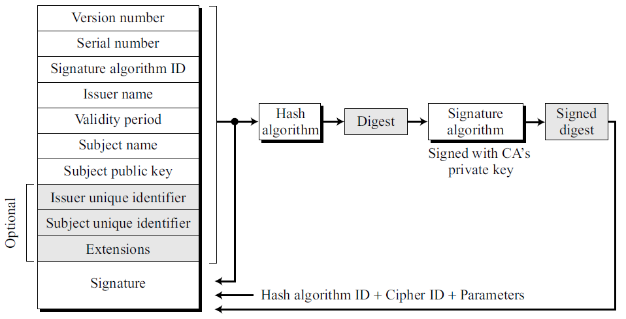
Public-Key Distribution – X.509 Certificate Format

Slide 34
Public-Key Distribution – X.509 Certification
Certificate Renewal
Each certificate has a period of validity. If there is no problem with the certificate, the CA issues a new certificate before the old one expires.
Certificate Revocation
In some cases, a certificate must be revoked before its expiration.
Delta Revocation
To make revocation more efficient, the delta certificate revocation list (delta CRL) has been introduced.

Slide 35
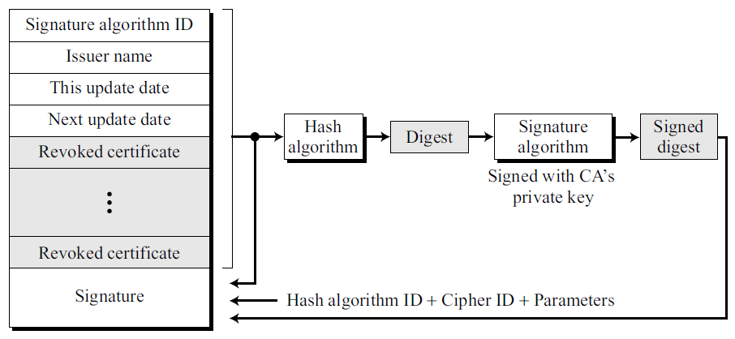
Public-Key Distribution – X.509 Certificate Revocation Format

Slide 36
PUBLIC-KEY INFRASTRUCTURE (PKI)

Slide 37
Public-Key Infrastructure (PKI)
Public-Key Infrastructure (PKI) is a model for creating, distributing, and revoking certificates based on the X.509.
The Internet Engineering Task Force (IETF) has created the PKI X.509 (PKIX).
There are several duties have been defined for a PKI:
Certificates’ issuing, renewal, and revocation.
Keys’ storage and update.
Providing services to other protocols.
Providing access control.

Slide 38
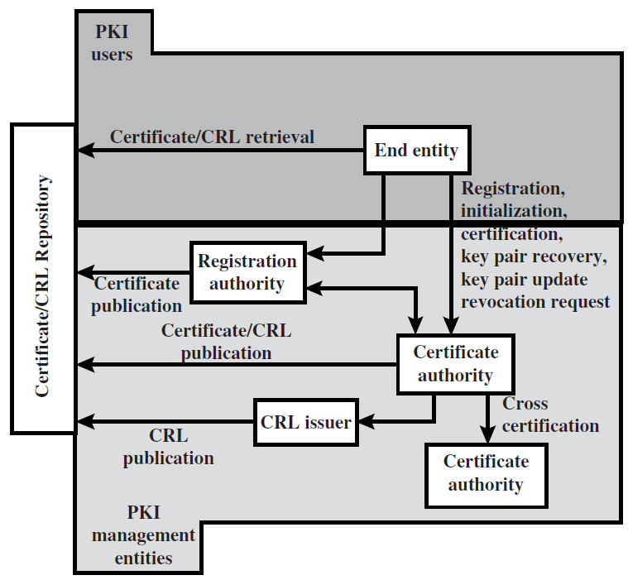
Public-Key Infrastructure X.509 (PKIX) Architectural Model

Slide 39
Main References for Chapter 14
Forouzan, B.A. “Introduction to Cryptography and Network Security”, Third Edition, McGraw-Hill, 2008.
Stallings, W. “Cryptography and Network Security: Principles and Practices”, Fifth Edition, Pearson Prentice Hall, 2011.

Slide 40
Way Forward…

Slide 41
Types Public-Key Cryptography
Encryption scheme
Key exchange mechanism
Key encapsulation mechanism
Digital signature scheme
Identification scheme
Identity-Based (ID) cryptography
Certificateless cryptography
Elliptic curve cryptography
Signcryption scheme
Hybrid cryptography
Pairing-Based cryptography
Quantum cryptography
Post-Quantum cryptography

Slide 42
Quantum Computing Era

Slide 43
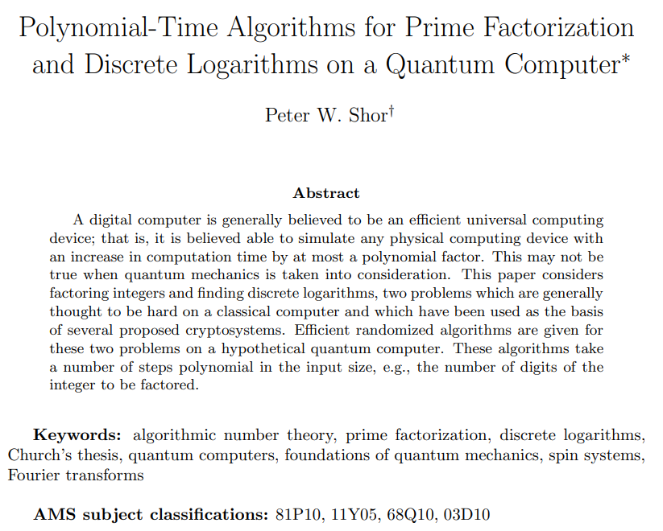
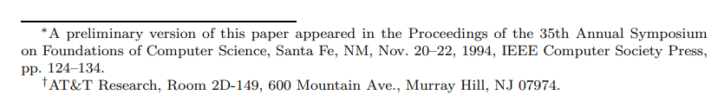
Quantum Cryptanalysis – Shor’s Algorithm

Slide 44
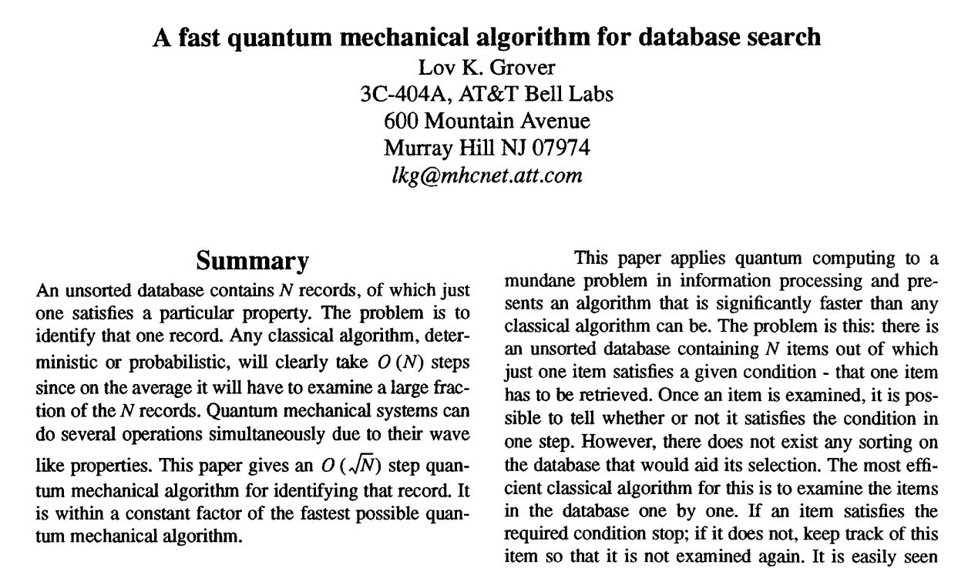
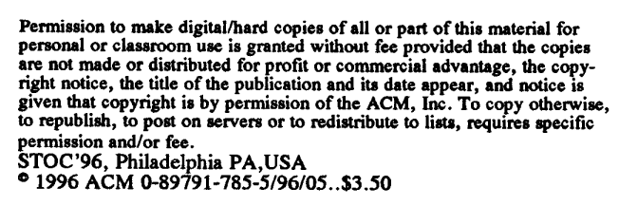
Quantum Cryptanalysis – Grover’s Algorithm

Slide 45

Quantum Cryptography

Slide 46
Quantum Cryptography
Quantum cryptography (also known as quantum encryption) refers to various cybersecurity methods for encrypting and transmitting secure data based on the naturally occurring and immutable laws of quantum mechanics (physics).
One of the famous quantum cryptography is the Quantum Key Distribution (QKD) – Bennett and Brassard scheme (BB84).

Slide 47
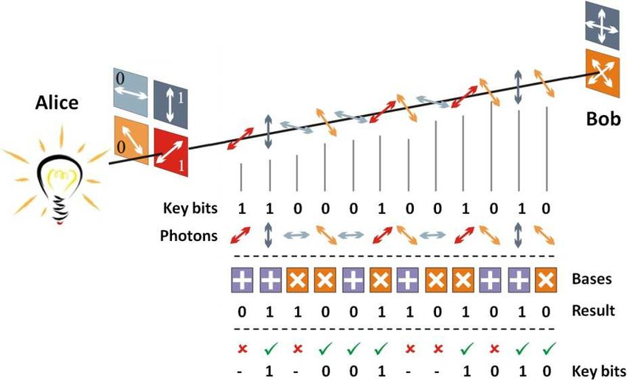

Slide 48
Post-Quantum Cryptography

Slide 49
Post-Quantum Cryptography
Cryptographic systems that are secure against both quantum and classical computers and can interoperate with existing communications protocols and networks.

Slide 50
Post-Quantum Cryptography Candidates (Primitives)
Hash-based cryptography
Code-based
Lattice-based
Multivariate Quadratic Polynomial
Elliptic-curve Isogeny-based

Slide 51
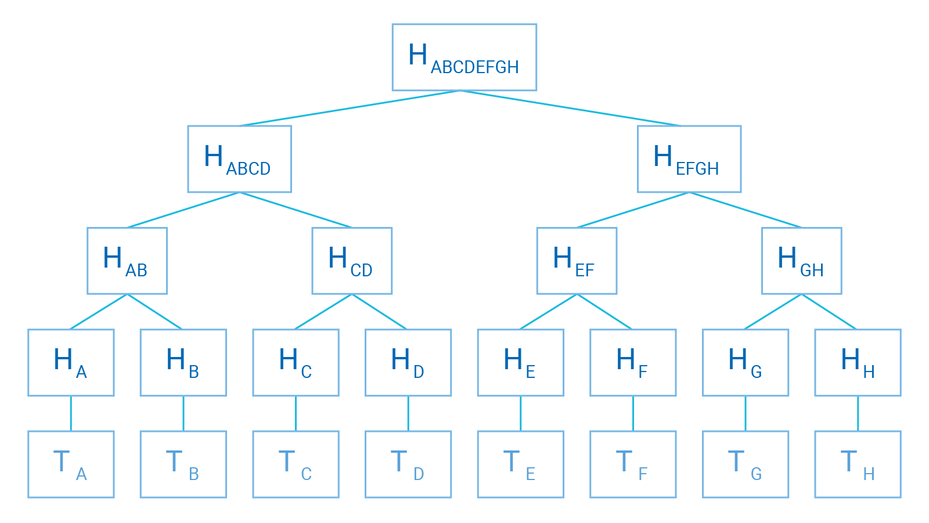
Hash-based Cryptography
The design of cryptography based on hash function.
The underlying security lies on the difficulty of finding:
Collision
Pre-Image
Second Pre-Image

Slide 52
Code-based Cryptography
The design of cryptography based on the coding theory – the error-correcting codes.
The Code-based Cryptography is closely related to lattices too.
The famous code-based cryptographic scheme – The McEliece cryptosystem.

Slide 53
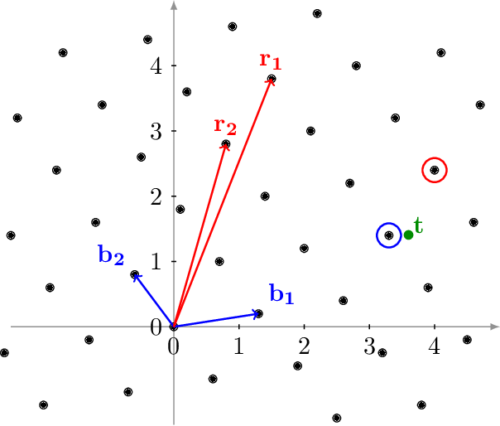
Lattice-based Cryptography
The design of cryptography based on lattice.
The underlying security lies on the difficulty of solving:
Shortest Vector Problem (SVP)
Closest Vector Problem (CVP)
Learning with Errors (LWE)

Slide 54
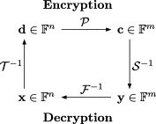
Multivariate Cryptography
The design of cryptography based on multivariate (quadratic) polynomial.
The underlying security lies on the difficulty of solving multivariate quadratic polynomial over finite field.

Slide 55
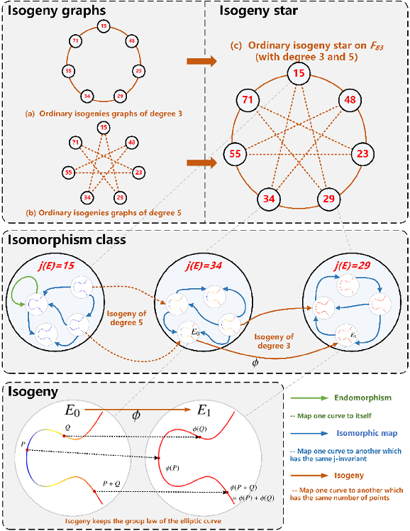
Multivariate Cryptography
The youngest candidate in the PQC.
The design of cryptography based on elliptic curve cryptography.
The underlying security lies on the difficulty of finding an isogeny star.

Slide 56
~ THE END ☺ ~

